Slide 1

Blockchain project
Antony Shenouda

Slide 2
Scope
The project's primary aim is to gain a comprehensive understanding of blockchain technology, oracles, ERC20, and ERC721 standards, while also exploring the essential tools and techniques necessary for creating blockchain-based applications.
Due to time limitations, I was only able to develop the smart contract responsible for generating the NFTs. Unfortunately, I couldn't complete the front-end using React, which was intended to interact with the deployed smart contract.

Slide 3
Features and functionalities
Smart Contract (NFTFactory):
Generates NFTs representing five different characters: OBAMA, STEVE_JOBS, EMMA_WATSON, TRUMP, and RONALDO.
Provides a "createCollectible" public function to create new NFTs, with character selection occurring randomly.
Allows the owner (or someone approved by the owner) to call the "setTokenURI" function to set the token URI for a given NFT based on the randomly selected character.

Slide 4
Architectural Design

Slide 5
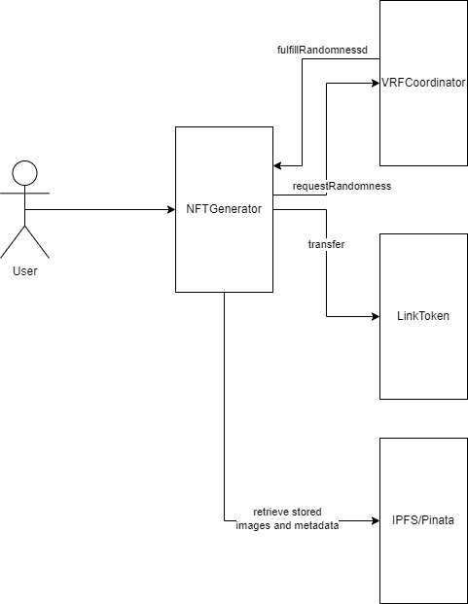
Component View

Slide 6
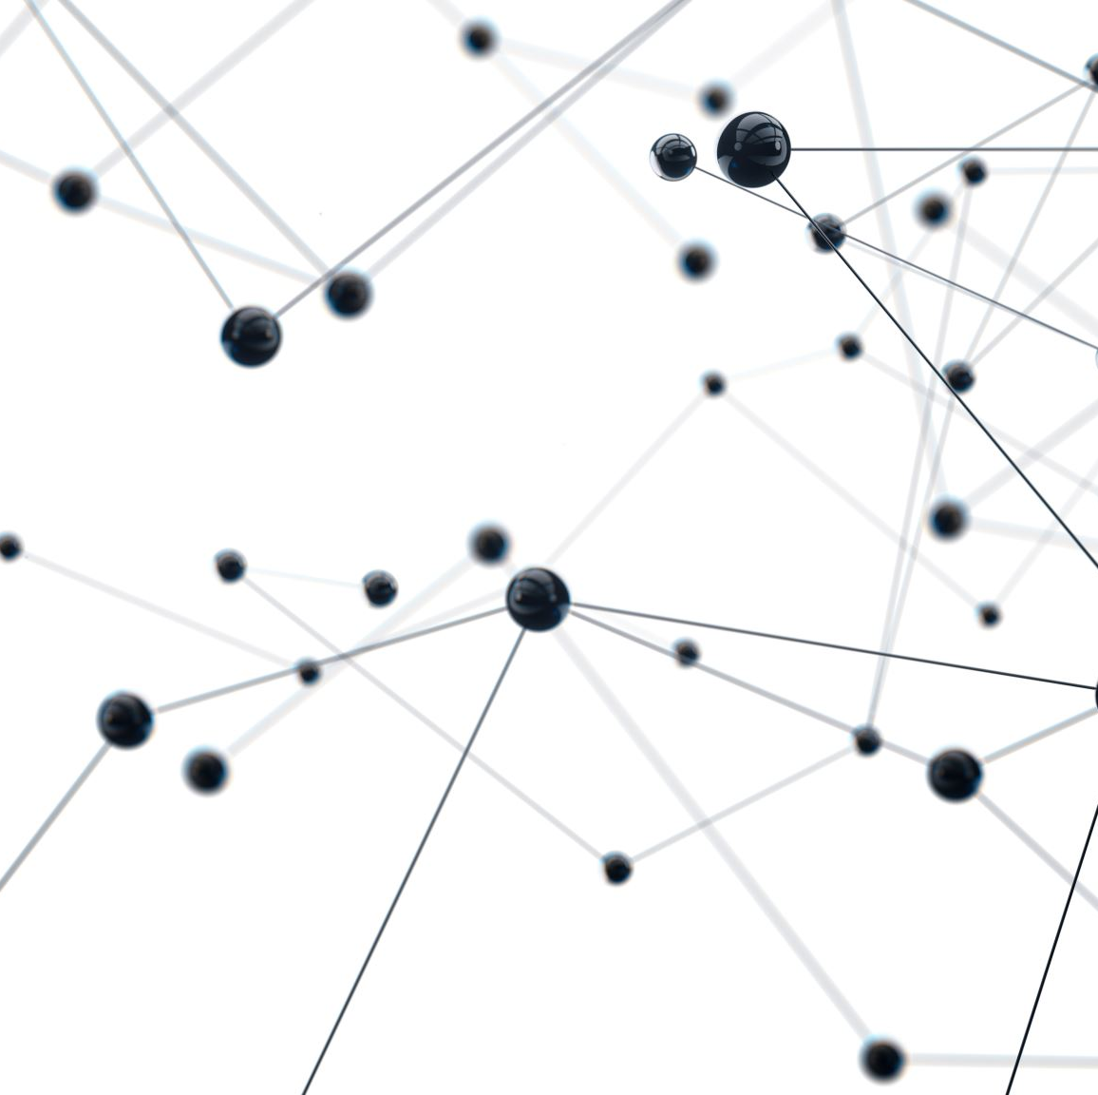
VRFCoordinator
It is a smart contract system used in blockchain networks, particularly in the context of Ethereum and Chainlink, to provide verifiably random and unpredictable numbers. It is needed in blockchain applications for several reasons:
Randomness in Smart Contracts
Deterministic Nature of Blockchains
Security and Fairness
External Data Sources

Slide 7
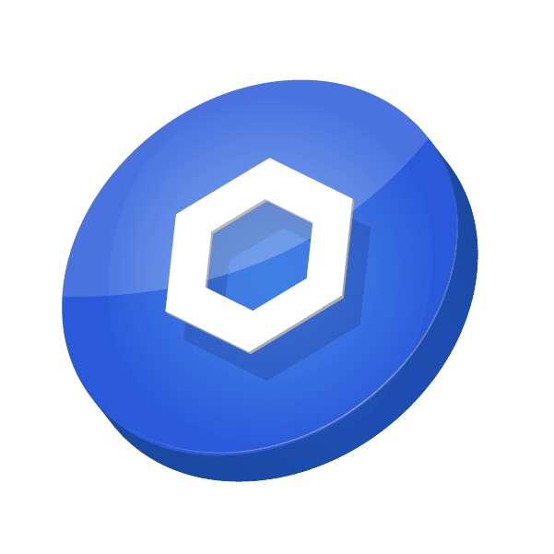
LinkToken
The LinkToken, often referred to as LINK, is the native cryptocurrency of the Chainlink network. It plays a crucial role in the operation of the Chainlink network, including the VRFCoordinator. In the context of the VRFCoordinator (Verifiable Random Function Coordinator), LINK tokens are needed for several purposes:
Paying node operators who provide verifiable randomness through the VRFCoordinator.
Providing collateral to ensure that node operators have a financial stake in generating truly random numbers and preventing manipulation.
Supporting the overall security and reliability of the VRFCoordinator's random number generation process.

Slide 8

IPFS/Pinata
IPFS (InterPlanetary File System) and Pinata are both tools used in the context of creating and managing NFTs (Non-Fungible Tokens) to store and distribute associated content such as images, metadata, and other digital assets.
IPFS: IPFS allows you to store files in a decentralized manner, meaning that files are not hosted on a single server but are distributed across a network of nodes (computers). This ensures that NFT content is not reliant on a single central server, enhancing security and availability.
Pinata: Pinata hosts IPFS nodes, making it easy for developers and NFT creators to interact with IPFS without setting up their own nodes. This eliminates the need for users to run their IPFS infrastructure.

Slide 9
Runtime View

Slide 10
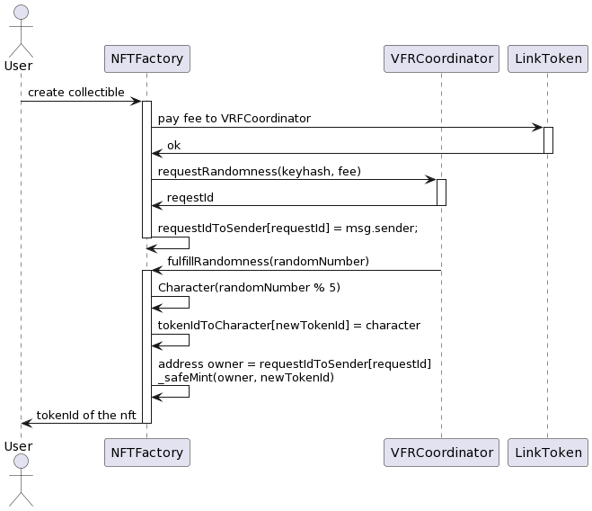
Create NFT

Slide 11
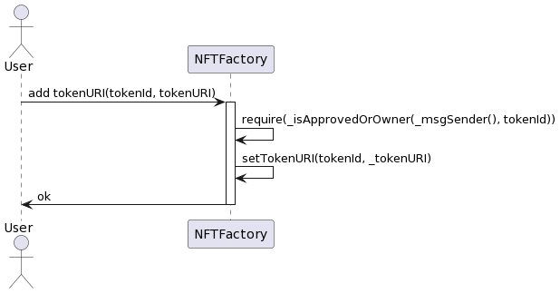
Add tokenURI to NFT

Slide 12
Implementation and Testing

Slide 13
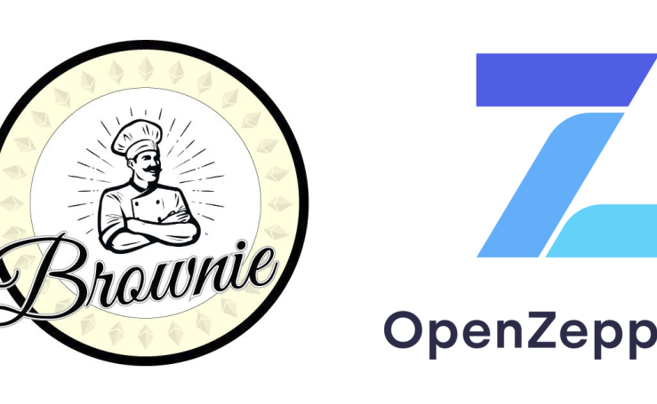
Brownie
Brownie is a popular development framework for Ethereum smart contracts and decentralized applications (DApps). It streamlines the process of developing, testing, and deploying smart contracts on the Ethereum blockchain. Here's a brief overview of how Brownie works:
Project Structure
Testing
Scripting
Network Management
Integration with Ganache and other Tools

Slide 14
Testing
In order to test the NFTFactory I have created contracts such as "LinkToken" and "VRFCoordinatorMock" specifically for deployment on the Ganache network. These mock contracts are essential components of the automated testing infrastructure.
Deploying these mock contracts on the Ganache network is a critical part of the testing strategy, as it allows us to thoroughly test smart contracts and ensure their reliability and functionality in a controlled and deterministic testing environment.

